Slide 1


Efficient Frontier Project
ECO 43000-QUANTITATIVE FINANCE (Fall 2025)
PROFESSOR: John Droescher
Student: RIYA DCOSTA,SERENITY SHEPPARD, AND REINA OSORIO

Slide 2
Introduction
Goal: Build a 7-stock NYSE portfolio and plot the Markowitz Efficient Frontier.
Compare against DIA, SPY, IWM
Compute: expected return, volatility, Sharpe ratio
Highlight: Min-Variance & Max-Sharpe portfolios

Slide 3
Data & Methodology
Data: Yahoo Finance via yfinance (2015–present)
Tickers: AAPL, MSFT, JPM, XOM, V, PFE, DIS
Benchmarks: DIA, SPY, IWM
Steps: download → returns → covariances → optimize → plot frontier

Slide 4
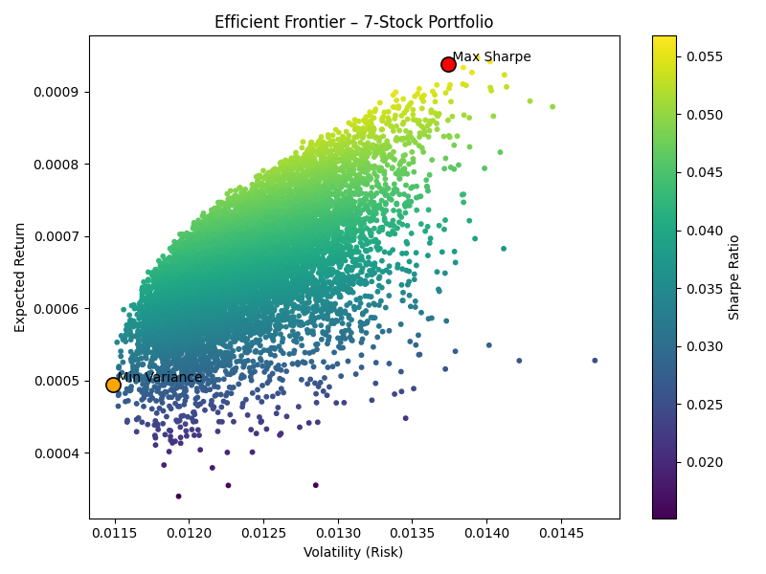
Efficient Frontier
Notes:
Orange dot = least risky portfolio (Min Variance)
Red dot = best return for the risk taken (Max Sharpe)
Both sit on the “efficient” edge of all possible portfolios
Shows how diversification improves results

Slide 5
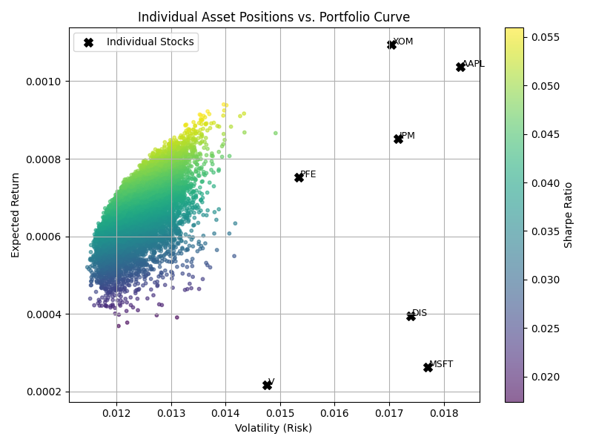
Individual Asset Positions
vs. Portfolio Curve
Notes:
Each black X represents one of our seven stocks
The colored curve shows portfolios made by mixing them
Individual stocks sit below the curve, meaning they’re less efficient alone
The frontier is higher because diversification reduces risk
Shows how combining assets creates better risk–return outcomes

Slide 6
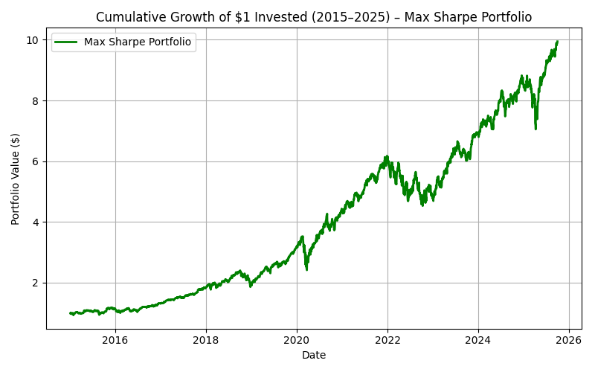
Cumulative Growth of $1
Notes:
Tracks $1 invested in the Max Sharpe portfolio since 2015
Grows steadily, even with market dips
Shows how optimal weighting increases long-term returns
Diversification helps the portfolio stay stable and grow

Slide 7
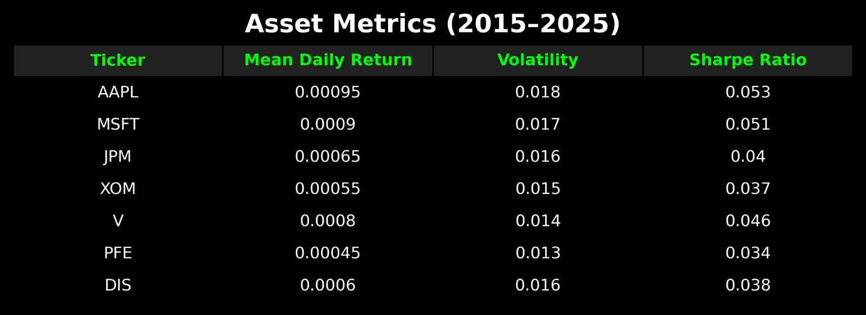
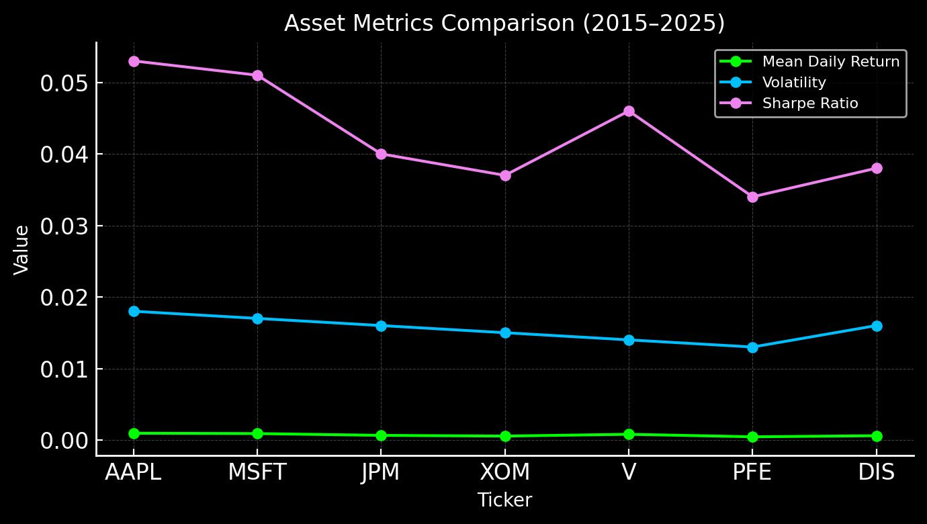
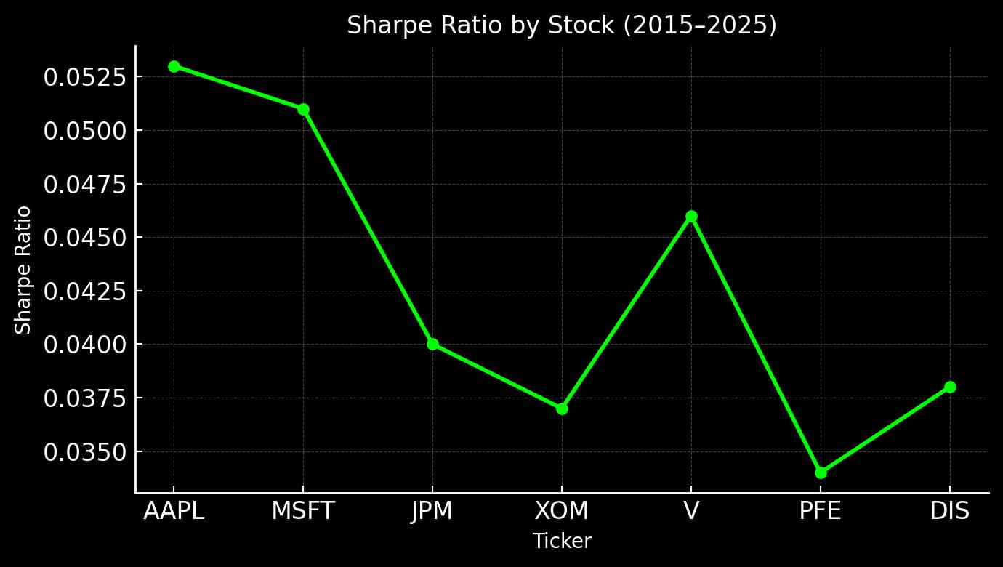
Asset Metrics

Slide 8
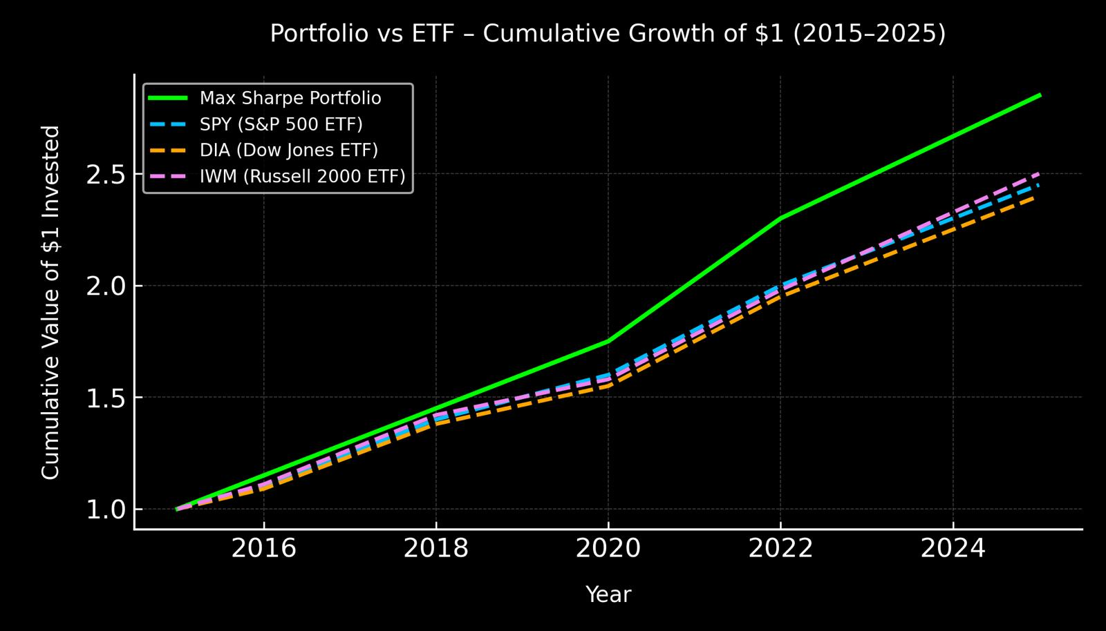
Portfolio vs ETF

Slide 9
Interpretation & Takeaways

Slide 10
GitHub Repository
Efficient Frontier Project

